Slide 1
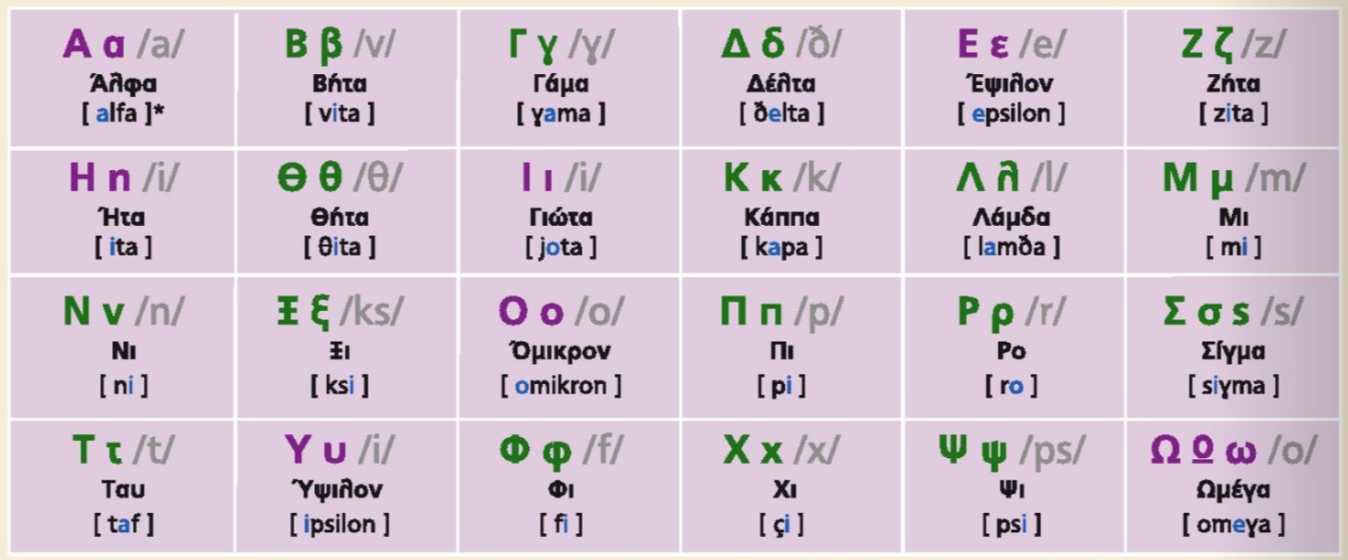


ΤΟ ΑΛΦΑΒΗΤΟ
Το αλφάβητο
Modern Greek (GRE1001) | Jacopo Mosesso | VIT University, July 2022

Slide 2
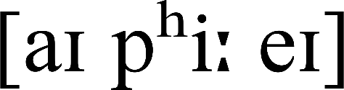
ΤΟ ΑΛΦΑΒΗΤΟ
Το αλφάβητο
Α α | άλφα | [a] | Άννα
Β β | βήτα | [v] | Βασίλης
Γ γ | γάμμα | [ɣ] | Γιάννης
Δ δ | δέλτα | [ð] | Δημήτρης
Ε ε | έψιλον | [e] | Ελένη
Ζ ζ | ζήτα | [z] | Ζωή
Η η | ήτα | [i] | Ηλίας
Θ θ | θήτα | [θ] | Θανάσης
Modern Greek (GRE1001) | Jacopo Mosesso | VIT University, July 2022

Slide 3
ΤΟ ΑΛΦΑΒΗΤΟ
Το αλφάβητο
Ι ι | γιώτα | [i] | Ιόλη
Κ κ | κάπα | [k] | Κατερίνα
Λ λ | λάμδα | [l] | Λίζα
Μ μ | μι | [m] | Μαρία
Ν ν | νι | [n] | Νίκος
Ξ ξ | ξι | [ks] | Ξανθή
Ο ο | όμικρον | [o] | Όλγα
Π π | πι | [p] | Πέτρος
Modern Greek (GRE1001) | Jacopo Mosesso | VIT University, July 2022

Slide 4
ΤΟ ΑΛΦΑΒΗΤΟ
Το αλφάβητο
Ρ ρ | ρο | [r] | Ρένα
Σ σ ς | σίγμα | [s] | Σοφία
Τ τ | ταυ | [t] | Τάσος
Υ υ | ύψιλον | [i] | Υβόννη
Φ φ | φι | [f] | Φανή
Χ χ | χι | [x] | Χαρά
Ψ ψ | ψι | [ps] | Καλυψώ
Ω ω | ωμέγα | [o] | Μυρτώ
Modern Greek (GRE1001) | Jacopo Mosesso | VIT University, July 2022

Slide 5
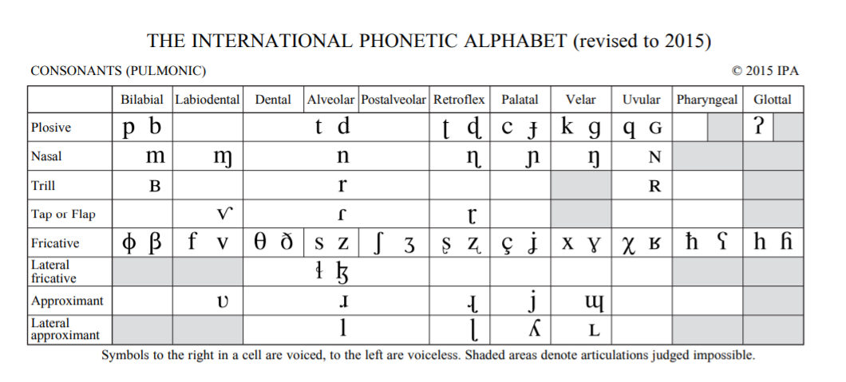
ΤΟ ΑΛΦΑΒΗΤΟ
Το αλφάβητο
Modern Greek (GRE1001) | Jacopo Mosesso | VIT University, July 2022

Slide 6
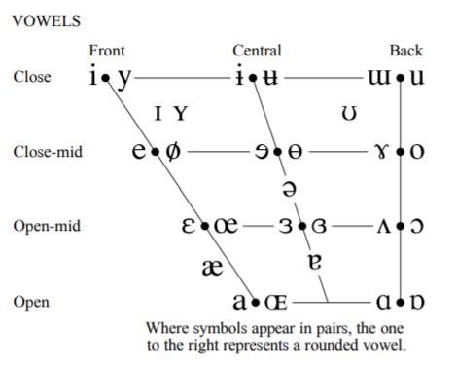
GRAPHEME | PHONEME
(how it’s written) | (how it sounds)
⟨α⟩ | /a/
⟨ε⟩ | /e/
⟨η⟩; ⟨ι⟩; ⟨υ⟩ | /i/
⟨ο⟩; ⟨ω⟩ | /o/
Τα φωνήεντα
Vowels
Modern Greek (GRE1001) | Jacopo Mosesso | VIT University, July 2022

Slide 7
What’s the correct name spelling?
α
άλφα
άλμα
Modern Greek (GRE1001) | Jacopo Mosesso | VIT University, July 2022

Slide 8
What’s the correct name spelling?
δ
δέλτα
δέητα
Modern Greek (GRE1001) | Jacopo Mosesso | VIT University, July 2022

Slide 9
What’s the correct name spelling?
ζ
ζι
ζήτα
Modern Greek (GRE1001) | Jacopo Mosesso | VIT University, July 2022

Slide 10
What’s the correct name spelling?
ο
όμικρον
όψιλον
Modern Greek (GRE1001) | Jacopo Mosesso | VIT University, July 2022

Slide 11
What’s the correct name spelling?
υ
ύψιλον
ύτα
Modern Greek (GRE1001) | Jacopo Mosesso | VIT University, July 2022

Slide 12
What’s the correct name spelling?
σ
σίγμα
σίρμα
Modern Greek (GRE1001) | Jacopo Mosesso | VIT University, July 2022

Slide 13
What’s the correct name spelling?
ω
ωμέγα
ώμελα
Modern Greek (GRE1001) | Jacopo Mosesso | VIT University, July 2022

Slide 14
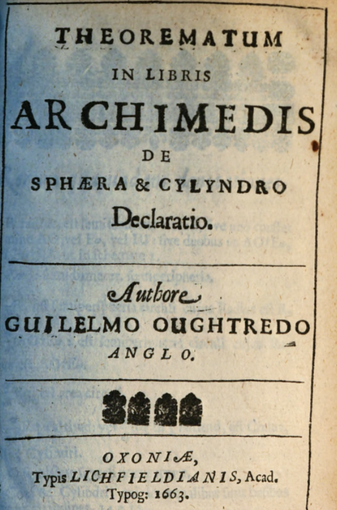
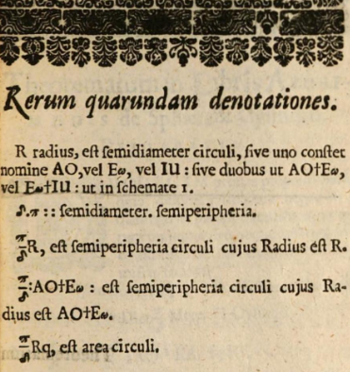
ΤΟ ΑΛΦΑΒΗΤΟ
Το αλφάβητο
Modern Greek (GRE1001) | Jacopo Mosesso | VIT University, July 2022

Slide 15
International Scientific Vocabulary (ISV)
“a part of the vocabulary of the sciences and other specialized studies that consists of words or other linguistic forms current in two or more languages and differing from New Latin in being adapted to the structure of the individual languages in which they appear —abbreviation ISV”
Modern Greek (GRE1001) | Jacopo Mosesso | VIT University, July 2022

Slide 16
International Scientific Vocabulary (ISV)
“some ISV words (like haploid) have been created by taking a word with a rather general and simple meaning from one of the languages of antiquity, usually Latin and Greek, and conferring upon it a very specific and complicated meaning for the purposes of modern scientific discourse”
Modern Greek (GRE1001) | Jacopo Mosesso | VIT University, July 2022

Slide 17
Asian Lexicography: Past, Present, and Prospective
by Tom McArthur
https://lexicala.com/review/2020/mcarthur-asian-lexicography/
“The word lexicography has the same Greco-Latin pedigree and structure as biology, astronomy, osteopathy, phylogeny, and other widely-used names for academic activities and subjects. As such, it is part of what the American dictionary editor Philip Gove (1963:7a) has called International Scientific Vocabulary (ISV). Although Gove has for his purposes treated such words as restricted to English, they are in reality ‘translinguistic’: they operate (with appropriate phonological and orthographic adaptations) in many languages that serve as mediums for education, culture, science, and technology: not only in, say, Russian, Spanish, Swedish, or English (European languages traditionally receptive to Classical word elements and patterns) but also in Japanese, Malay, Tagalog/Pilipino, and other Asian languages (to which they are often transmitted through modern European languages). In effect, such words have no ultimate canonical forms: their embodiments in any language are all equally valid as citation forms. Because no language-specific version of such a term has primacy, an ISV word is truly international, transcending individual languages, a point which lexicographers worldwide have yet to come to terms with. ISV words would appear to be – both in their own right and through any loan translations that may have been made from them – the most universal set of lexical items on earth.”
Modern Greek (GRE1001) | Jacopo Mosesso | VIT University, July 2022

Slide 18
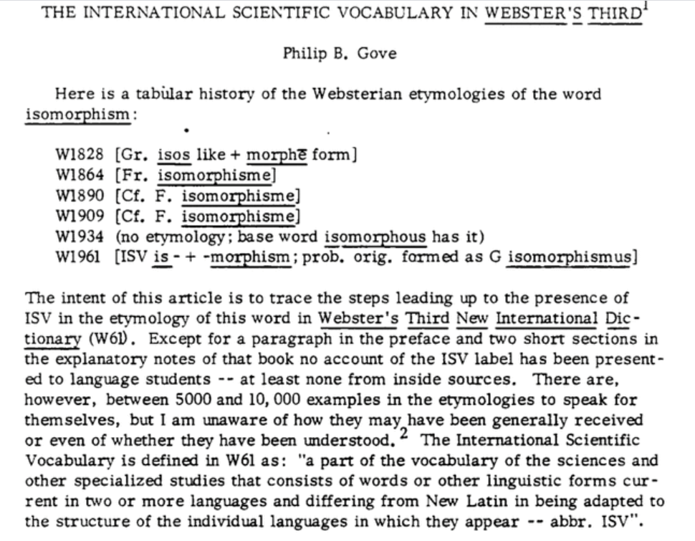
International Scientific Vocabulary (ISV)
The International Scientific Vocabulary in Webster's Third
Philip B. Gove
First Published March 1, 1968 Research Article
https://doi.org/10.1177/007542426800200101
Modern Greek (GRE1001) | Jacopo Mosesso | VIT University, July 2022

Slide 19
International Scientific Vocabulary (ISV)
cardiology
Kardiologie
cardiologia
cardiologie
καρδιά
Modern Greek (GRE1001) | Jacopo Mosesso | VIT University, July 2022

Slide 20
International Scientific Vocabulary (ISV)
cardiology
Kardiologie
cardiologia
cardiologie
καρδιά
cardi- (prefix)
-logy (suffix)
Modern Greek (GRE1001) | Jacopo Mosesso | VIT University, July 2022

Slide 21
International Scientific Vocabulary (ISV)
кардиология [Russian]
kardiyoloji [Turkish]
kardyolohiya [Tagalog]
kardiologi [Bahasa Indonesia]
कार्डियलजी [Hindi]
കാർഡിയോളജി [Malayalam]
καρδιά
Modern Greek (GRE1001) | Jacopo Mosesso | VIT University, July 2022

